Slide 1
Pom Pom Evolution
Evolution by Natural Selection
Adapted from the University of California, Los Angeles Life Sciences 1 Demonstration Manual
Copyright 2010 by Drs. Jennifer Doherty and Ingrid Waldron, Department of Biology, University of Pennsylvania1

Slide 2
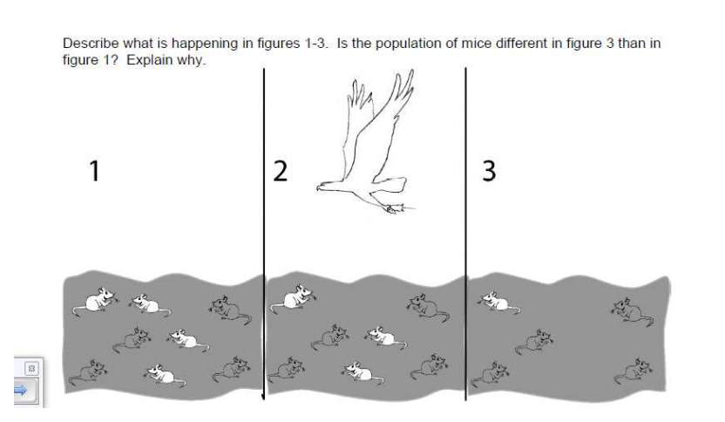

Slide 3
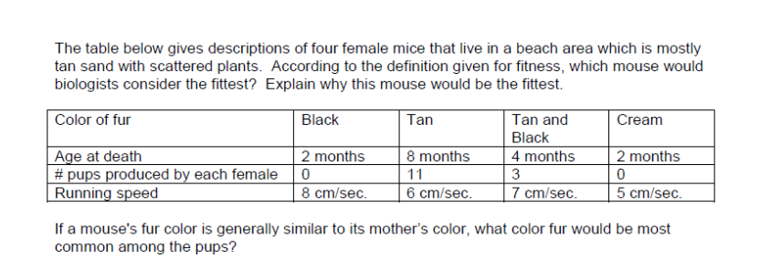

Slide 4
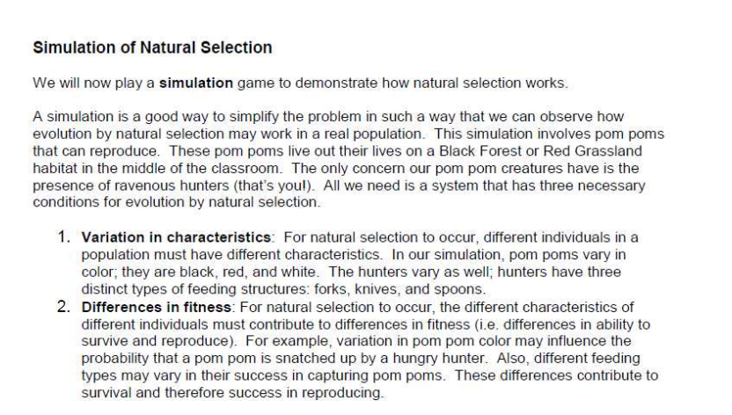



Slide 5
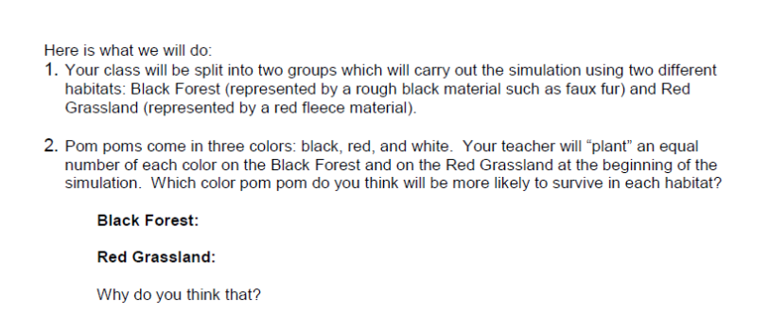

Slide 6
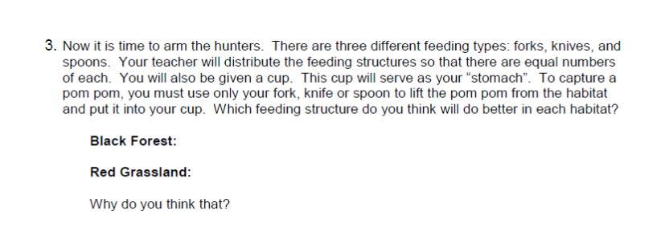

Slide 7
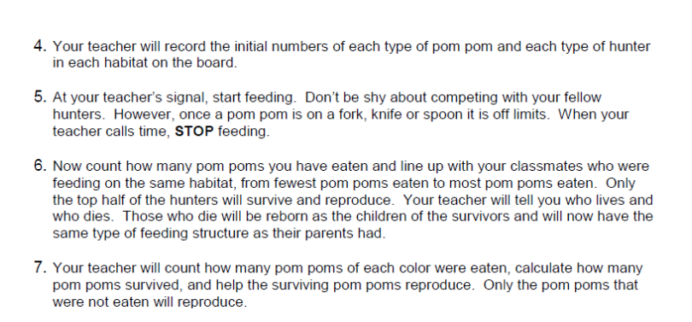

Slide 8
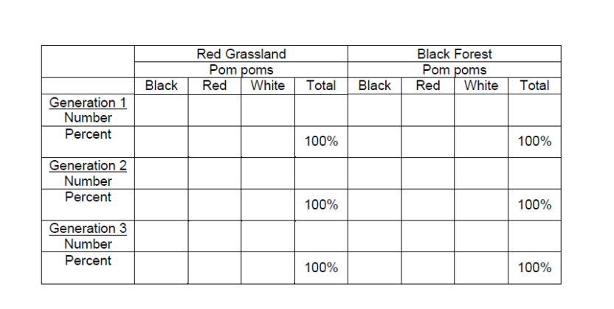

Slide 9


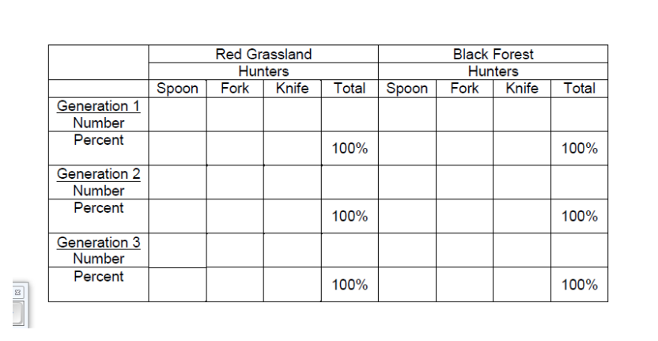

Slide 10
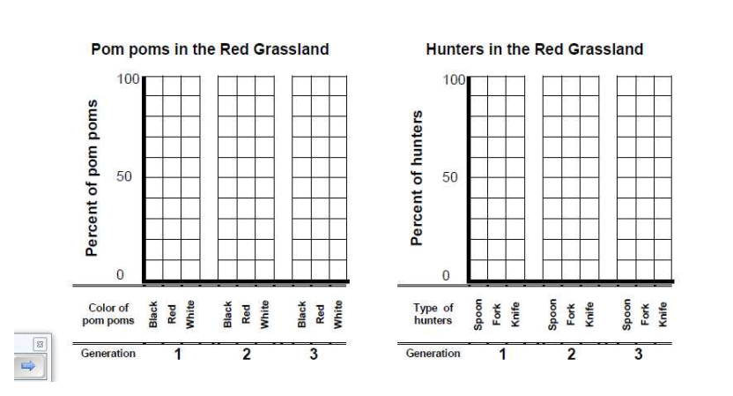

Slide 11
